Slide 1
對半心人的呼喚 Calling for the Half-Hearted People
士師記 Judges 13-16
Notes:
https://en.wikipedia.org/wiki/Fall_of_Mosul

Slide 2
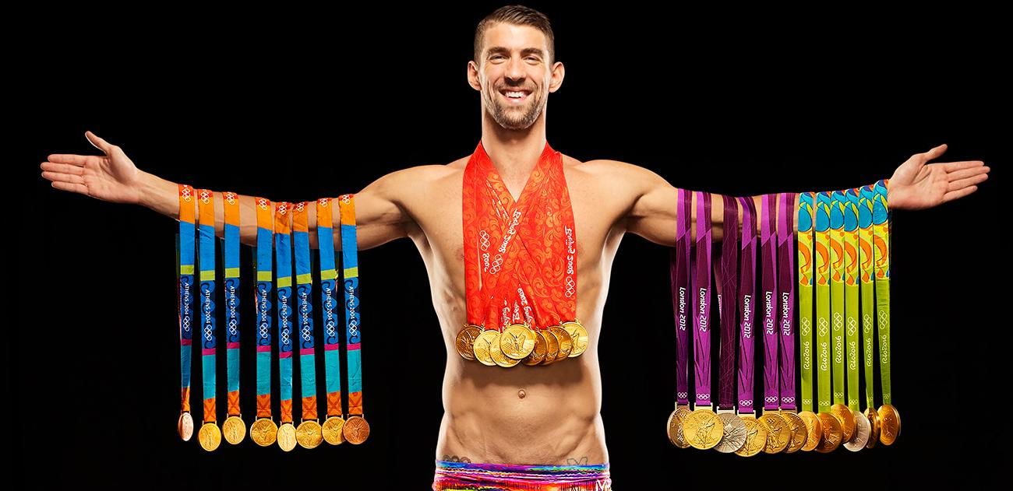
菲比斯 Michael Phelps

Slide 3
Notes:
http://www.bastillepost.com/hongkong/article/2786546?variant=zh-tw
http://www.cnn.com/2018/01/19/health/michael-phelps-depression/index.html

Slide 4
參孫

Slide 5
1. 萬千寵愛在一身 Lavish with Love (13)
Judges 13:1–2 ¹ 以色列人又行耶和華眼中看為惡的事，耶和華將他們交在非利士人手中四十年。 ² 那時，有一個瑣拉人，是屬但族的，名叫瑪挪亞。他的妻不懷孕，不生育。
¹ Again the Israelites did evil in the eyes of the Lord, so the Lord delivered them into the hands of the Philistines for forty years. ² A certain man of Zorah, named Manoah, from the clan of the Danites, had a wife who was childless, unable to give birth.

Slide 6
Judges 13:3
³ 耶和華的使者向那婦人顯現，對她說：「向來你不懷孕，不生育，如今你必懷孕生一個兒子。
³ The angel of the Lord appeared to her and said, “You are barren and childless, but you are going to become pregnant and give birth to a son.

Slide 7
Judges 13:5
⁵ … 這孩子一出胎就歸上帝作拿細耳人。他必起首拯救以色列人脫離非利士人的手。」
⁵ … the boy is to be a Nazirite, dedicated to God from the womb. He will take the lead in delivering Israel from the hands of the Philistines.”

Slide 8
Judges 13:5
⁵ … 這孩子一出胎就歸上帝作拿細耳人。他必起首拯救以色列人脫離非利士人的手。」
⁵ … the boy is to be a Nazirite, dedicated to God from the womb. He will take the lead in delivering Israel from the hands of the Philistines.”

Slide 9
Judges 13:4–5
⁴ 所以你當謹慎，清酒濃酒都不可喝，一切不潔之物也不可吃。⁵ 你必懷孕生一個兒子，不可用剃頭刀剃他的頭，因為這孩子一出胎就歸上帝作拿細耳人。
⁴ Now see to it that you drink no wine or other fermented drink and that you do not eat anything unclean. ⁵ You will become pregnant and have a son whose head is never to be touched by a razor because the boy is to be a Nazirite,

Slide 10
Judges 13:24–25
²⁴ 後來婦人生了一個兒子，給他起名叫參孫。孩子長大，耶和華賜福與他。²⁵ 在瑪哈尼•但，就是瑣拉和以實陶中間，耶和華的靈才感動他。
²⁴ The woman gave birth to a boy and named him Samson. He grew and the Lord blessed him, ²⁵ and the Spirit of the Lord began to stir him while he was in Mahaneh Dan, between Zorah and Eshtaol.

Slide 11
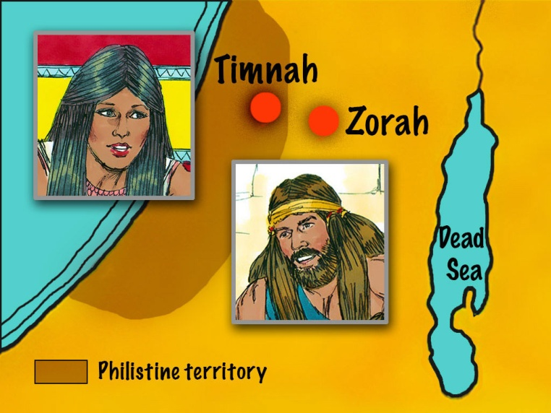
2. 順著肉體而活 Driven by lust (14-16)
亭拿
瑣拉

Slide 12
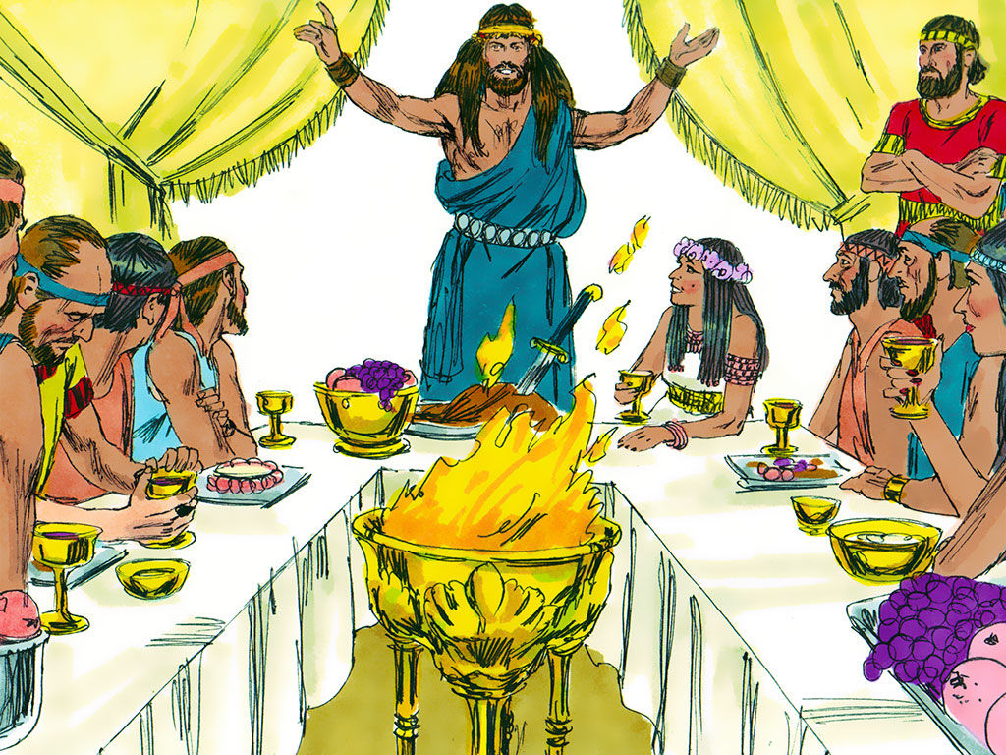

Slide 13
Judges 14:3 ³ 他父母說：「在你弟兄的女兒中，或在本國的民中，豈沒有一個女子，何致你去在未受割禮的非利士人中娶妻呢？」參孫對他父親說：「願你給我娶那女子，因我喜悅她。」
³ His father and mother replied, “Isn’t there an acceptable woman among your relatives or among all our people? Must you go to the uncircumcised Philistines to get a wife?” But Samson said to his father, “Get her for me. She’s the right one for me.”

Slide 14
Judges 14:8–9
⁸ 過了些日子，再下去要娶那女子，轉向道旁要看死獅，見有一群蜂子和蜜在死獅之內，⁹ 就用手取蜜，且吃且走
⁸ Some time later, when he went back to marry her, he turned aside to look at the lion’s carcass, and in it he saw a swarm of bees and some honey. ⁹ He scooped out the honey with his hands and ate as he went along.

Slide 15
Judges 14:10
¹⁰ 他父親下去見女子。參孫在那裏設擺筵宴，因為向來少年人都有這個規矩。
¹⁰ Now his father went down to see the woman. And there Samson held a feast, as was customary for young men.

Slide 16
1 Peter 2:9
⁹ 惟有你們是被揀選的族類，是有君尊的祭司，是聖潔的國度，是屬上帝的子民，要叫你們宣揚那召你們出黑暗入奇妙光明者的美德。
⁹ But you are a chosen people, a royal priesthood, a holy nation, God’s special possession, that you may declare the praises of him who called you out of darkness into his wonderful light.

Slide 17
1 Peter 2:11
¹¹ 親愛的弟兄啊，你們是客旅，是寄居的。我勸你們要禁戒肉體的私慾；這私慾是與靈魂爭戰的。
¹¹ Dear friends, I urge you, as foreigners and exiles, to abstain from sinful desires, which wage war against your soul.

Slide 18
3. 神的管教 Disciplined by God
Hebrews 12:6
⁶ 因為主所愛的，他必管教， 又鞭打凡所收納的兒子。
⁶ because the Lord disciplines the one he loves, and he chastens everyone he accepts as his son.”

Slide 19
Ecclesiastes 1:14
¹⁴ 我見日光之下所做的一切事，都是虛空，都是捕風。
¹⁴ I have seen all the things that are done under the sun; all of them are meaningless, a chasing after the wind.

Slide 20
Judges 16:1–2 ¹ 參孫到了迦薩，在那裏看見一個妓女，就與她親近。² 有人告訴迦薩人說：「參孫到這裏來了！」他們就把他團團圍住，終夜在城門悄悄埋伏，說：「等到天亮我們便殺他。」
¹ One day Samson went to Gaza, where he saw a prostitute. He went in to spend the night with her. ² The people of Gaza were told, “Samson is here!” So they surrounded the place and lay in wait for him all night at the city gate. They made no move during the night, saying, “At dawn we’ll kill him.”

Slide 21
Psalm 16:4
⁴ 以別神代替耶和華的， 他們的愁苦必加增。
⁴ Those who run after other gods will suffer more and more.

Slide 22
Judges 16:4
⁴ 後來，參孫在梭烈谷喜愛一個婦人，名叫大利拉。
⁴ Some time later, he fell in love with a woman in the Valley of Sorek whose name was Delilah.

Slide 23
Judges 16:5 ⁵ 非利士人的首領上去見那婦人，對她說：「求你誆哄參孫，探探他因何有這麼大的力氣，我們用何法能勝他，捆綁剋制他。我們就每人給你一千一百舍客勒銀子。」
⁵ The rulers of the Philistines went to her and said, “See if you can lure him into showing you the secret of his great strength and how we can overpower him so we may tie him up and subdue him. Each one of us will give you eleven hundred shekels of silver.”

Slide 24
Judges 16:6
⁶ 大利拉對參孫說：「求你告訴我，你因何有這麼大的力氣，當用何法捆綁剋制你。」
⁶ So Delilah said to Samson, “Tell me the secret of your great strength and how you can be tied up and subdued.”

Slide 25
Judges 16:16–17 ¹⁶ 大利拉天天用話催逼他，甚至他心裏煩悶要死。¹⁷ 參孫就把心中所藏的都告訴了她，對她說：「向來人沒有用剃頭刀剃我的頭，因為我自出母胎就歸上帝作拿細耳人；若剃了我的頭髮，我的力氣就離開我，我便軟弱像別人一樣。」
¹⁶ With such nagging she prodded him day after day until he was sick to death of it. ¹⁷ So he told her everything. “No razor has ever been used on my head,” he said, “because I have been a Nazirite dedicated to God from my mother’s womb. If my head were shaved, my strength would leave me, and I would become as weak as any other man.”

Slide 26
Judges 16:19
¹⁹ 大利拉使參孫枕著她的膝睡覺，叫了一個人來剃除他頭上的七條髮綹。於是大利拉剋制他，他的力氣就離開他了。
¹⁹ After putting him to sleep on her lap, she called for someone to shave off the seven braids of his hair, and so began to subdue him. And his strength left him.

Slide 27
Judges 16:21
²¹ 非利士人將他拿住，剜了他的眼睛，帶他下到迦薩，用銅鍊拘索他；他就在監裏推磨。
²¹ Then the Philistines seized him, gouged out his eyes and took him down to Gaza. Binding him with bronze shackles, they set him to grinding grain in the prison.

Slide 28
Hebrews 12:11
¹¹ 凡管教的事，當時不覺得快樂，反覺得愁苦；後來卻為那經練過的人結出平安的果子，就是義。
¹¹ No discipline seems pleasant at the time, but painful. Later on, however, it produces a harvest of righteousness and peace for those who have been trained by it.

Slide 29
Judges 16:22
²² 然而他的頭髮被剃之後，又漸漸長起來了。
²² But the hair on his head began to grow again after it had been shaved.

Slide 30
Judges 16:28
²⁸ 參孫求告耶和華說：「主耶和華啊，求你眷念我。上帝啊，求你賜我這一次的力量，使我在非利士人身上報那剜我雙眼的仇。」
²⁸ Then Samson prayed to the Lord, “Sovereign Lord, remember me. Please, God, strengthen me just once more, and let me with one blow get revenge on the Philistines for my two eyes.”

Slide 31
Judges 16:29–30 ²⁹ 參孫就抱住托房的那兩根柱子：左手抱一根，右手抱一根，³⁰ 說：「我情願與非利士人同死！」… 這樣，參孫死時所殺的人比活著所殺的還多。
²⁹ Then Samson reached toward the two central pillars on which the temple stood. Bracing himself against them, his right hand on the one and his left hand on the other, ³⁰ Samson said, “Let me die with the Philistines!” … Thus he killed many more when he died than while he lived.

